Slide 1
Process Control Train Project
Computer Science Bachelor, IN.4028, UNIFR
semester IV, SP 2020
Group 9 : David Baschung, Alex Guardini

Slide 2
Summary
Graphical User Interface
Observers
Demonstration
Obstacles, improvements

Slide 3
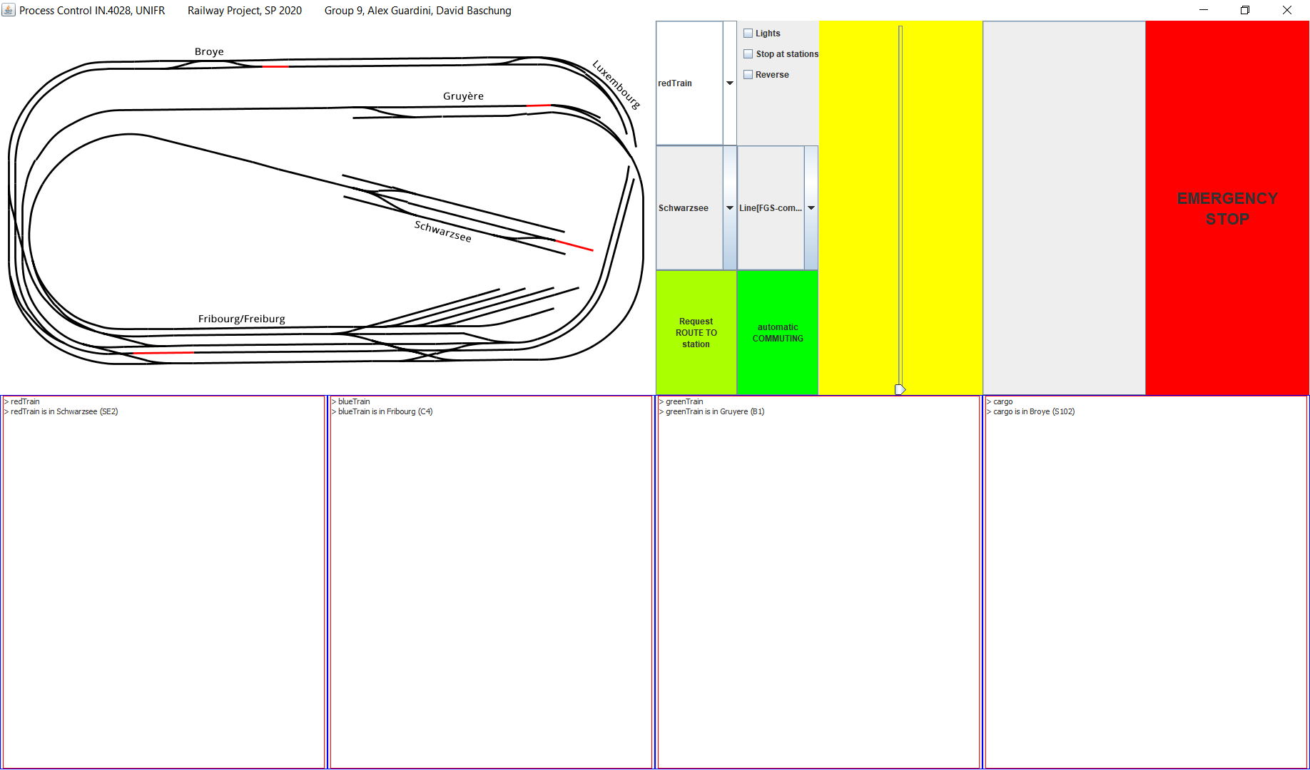
Graphical User Interface

Slide 4
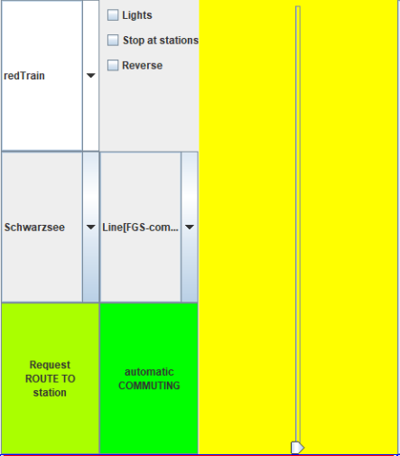
Interface commands
Select a train
Manual control of the selected train
Select a destination & request a route
Select a Line and Follow it indefinitely
Emergency stop

Slide 5
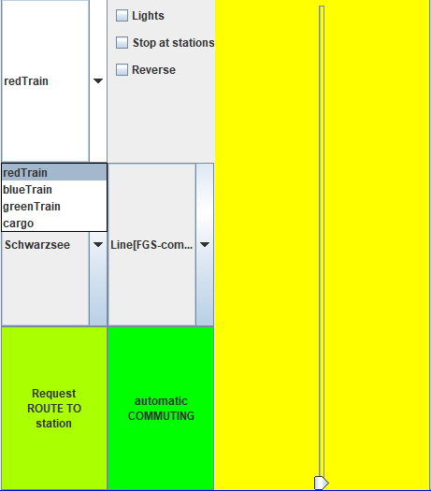
Interface commands
Select a train
Manual control of the selected train
Select a destination & request a route
Select a Line and Follow it indefinitely
Emergency stop

Slide 6
Interface commands
Select a train
Manual control of the selected train
Select a destination & request a route
Select a Line and Follow it indefinitely
Emergency stop

Slide 7
Interface commands
Select a train
Manual control of the selected train
Select a destination & request a route
Select a Line and Follow it indefinitely
Emergency stop

Slide 8
Interface commands
Select a train
Manual control of the selected train
Select a destination & request a route
Select a Line and Follow it indefinitely
Emergency stop

Slide 9
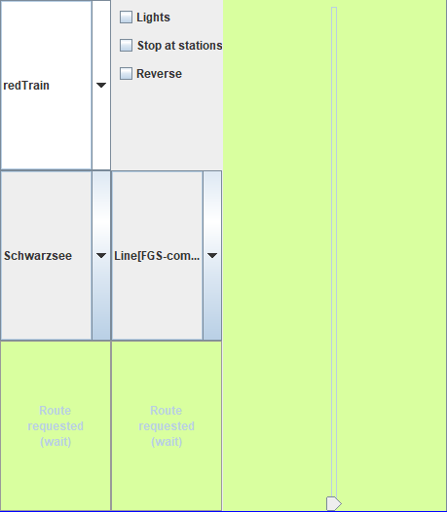
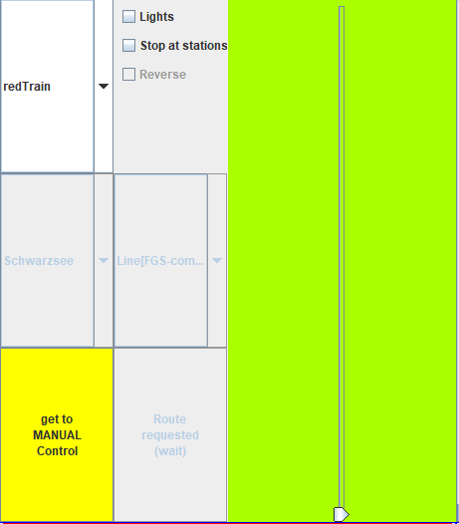
Interface commands, 3 modes :
Manual Waiting for the Route / Line access Routing / Commuting

Slide 10

Interface commands
Select a train
Manual control of the selected train
Select a destination & request a route
Select a Line and Follow it indefinitely
Emergency stop

Slide 11
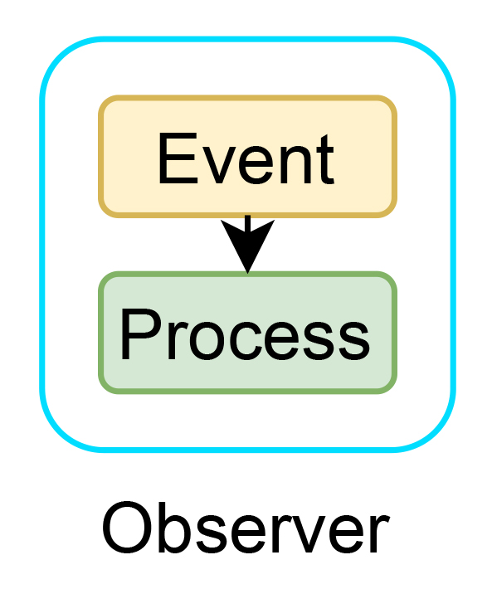
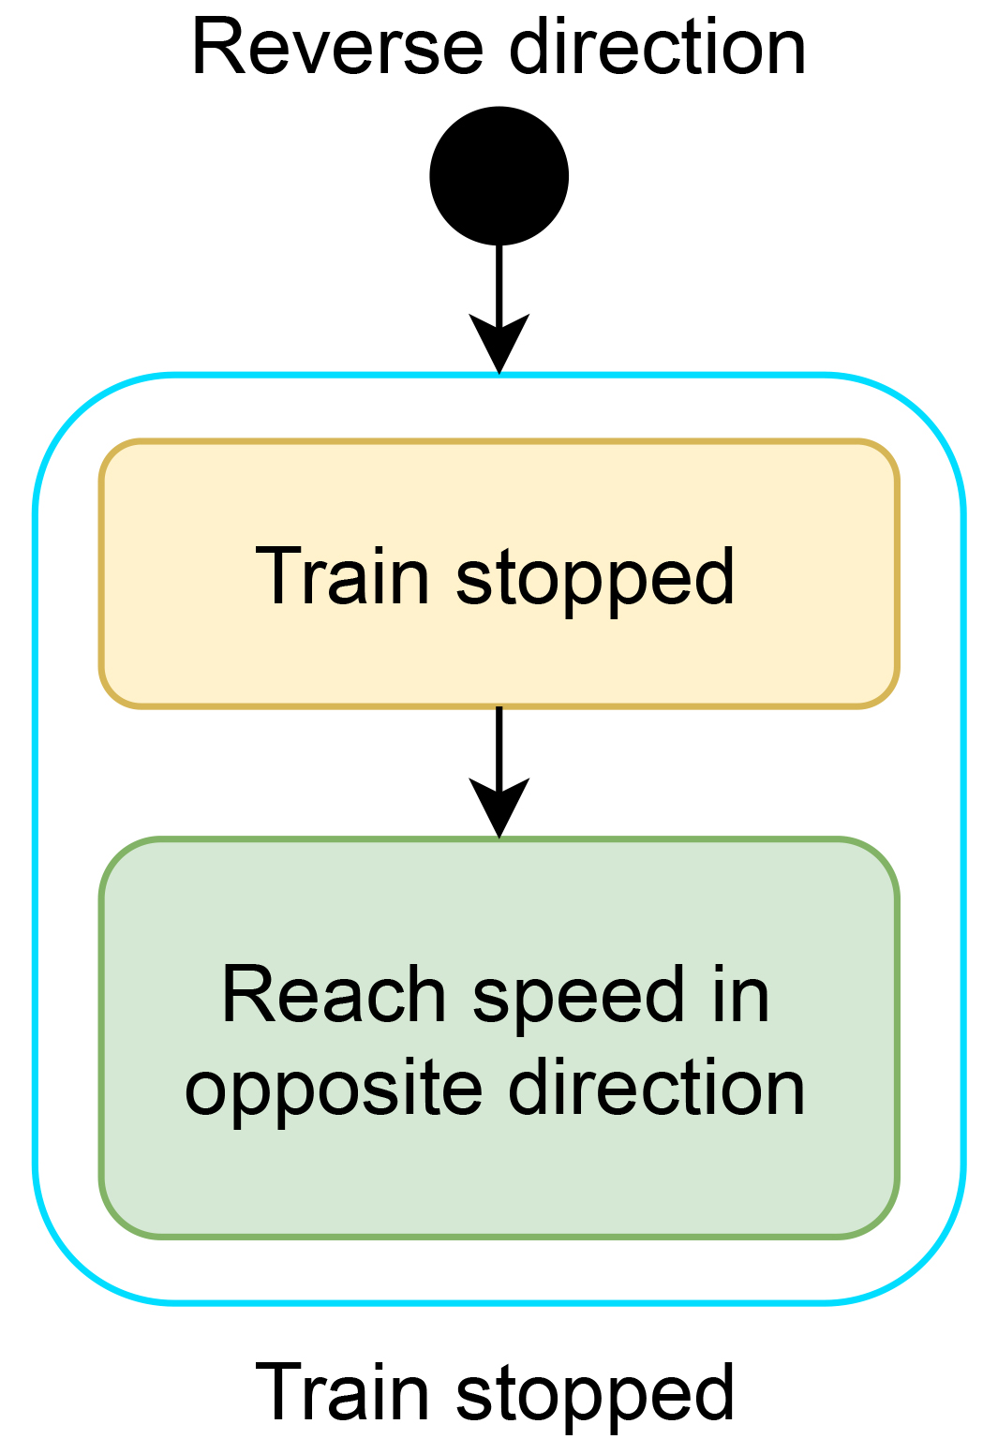
Observers
One manual observer, for «reverse» checkbox :
Other observers work in automatic modes

Slide 12
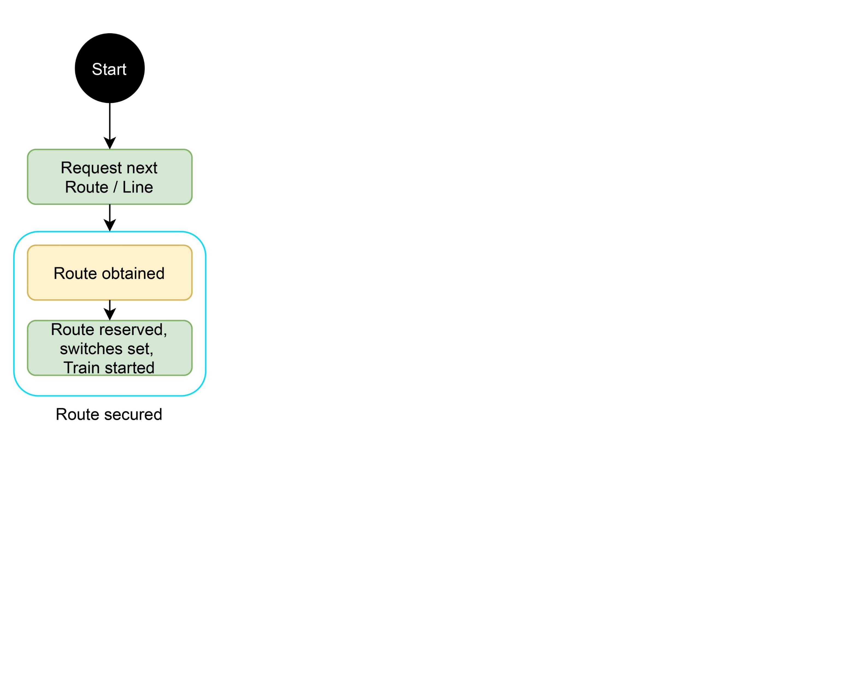

Slide 13
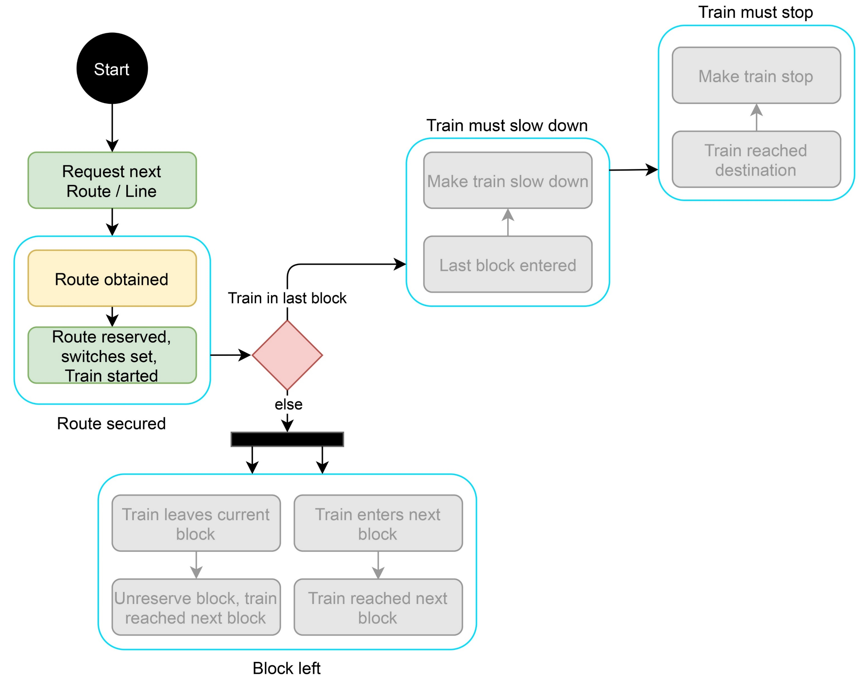

Slide 14
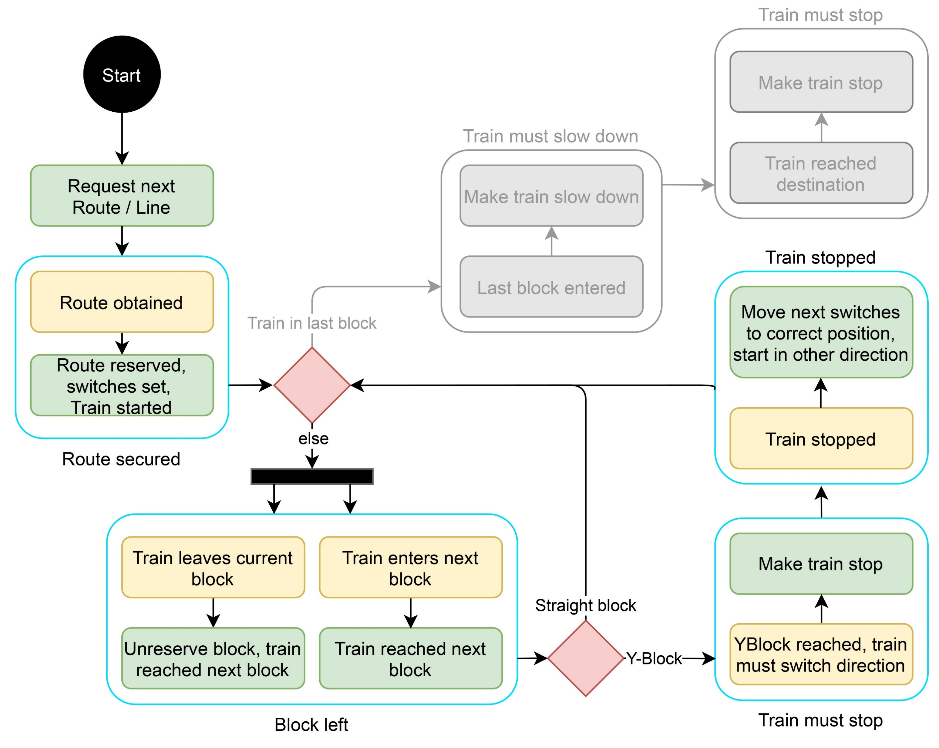

Slide 15
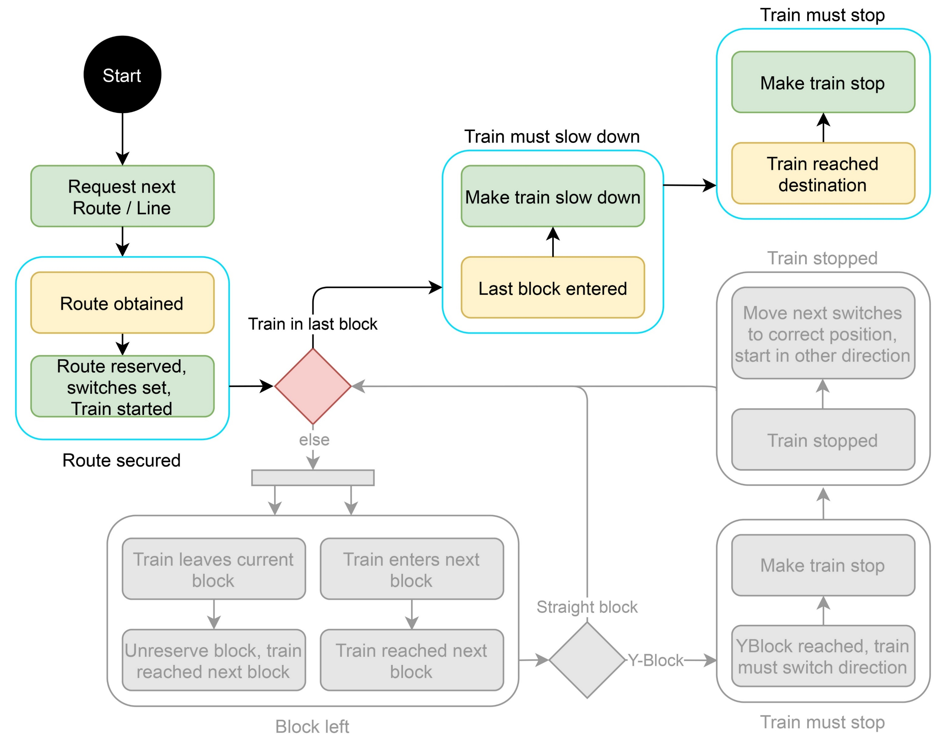

Slide 16
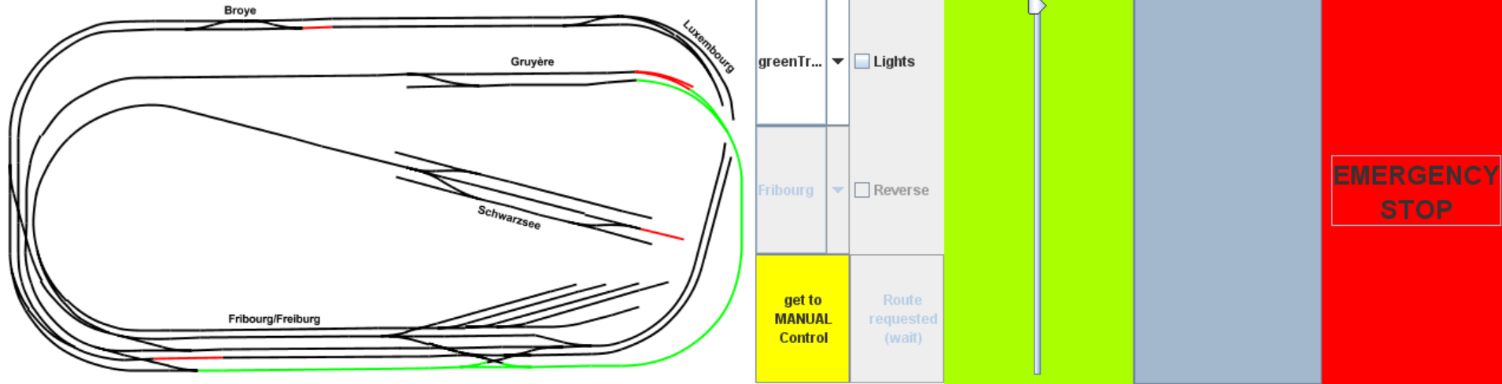
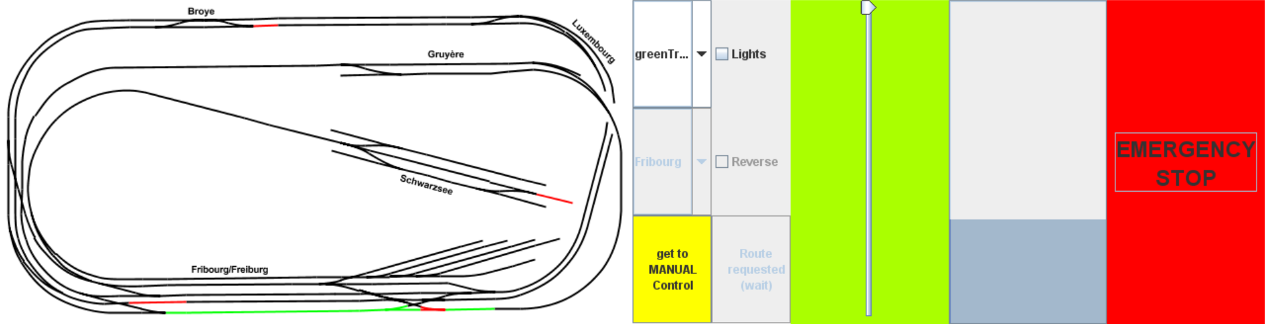
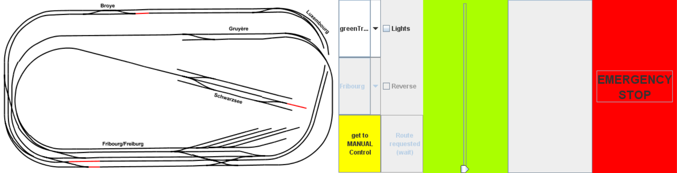
OnTrainMustSlowDown and OnTrainMustStop
Why slow down the train ?
→ No train starts slowing down when it reached its destination!
If the train is in the last block, slow down to speed 10
If the train is on the last sector of the last block, the train stops.

Slide 18
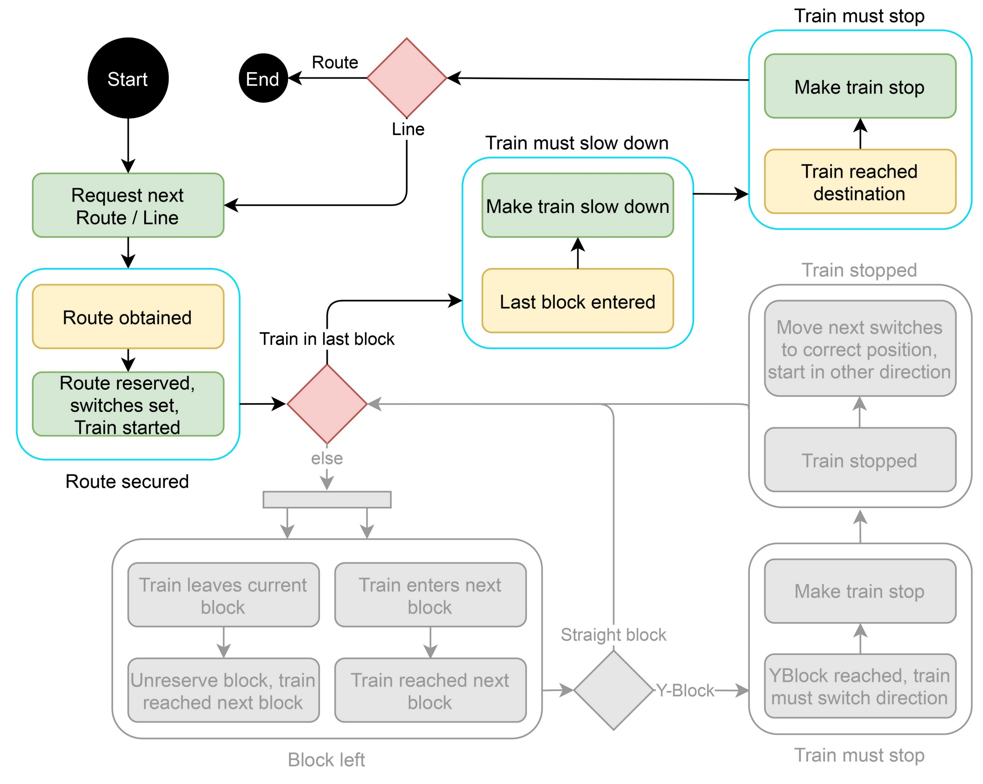

Slide 19
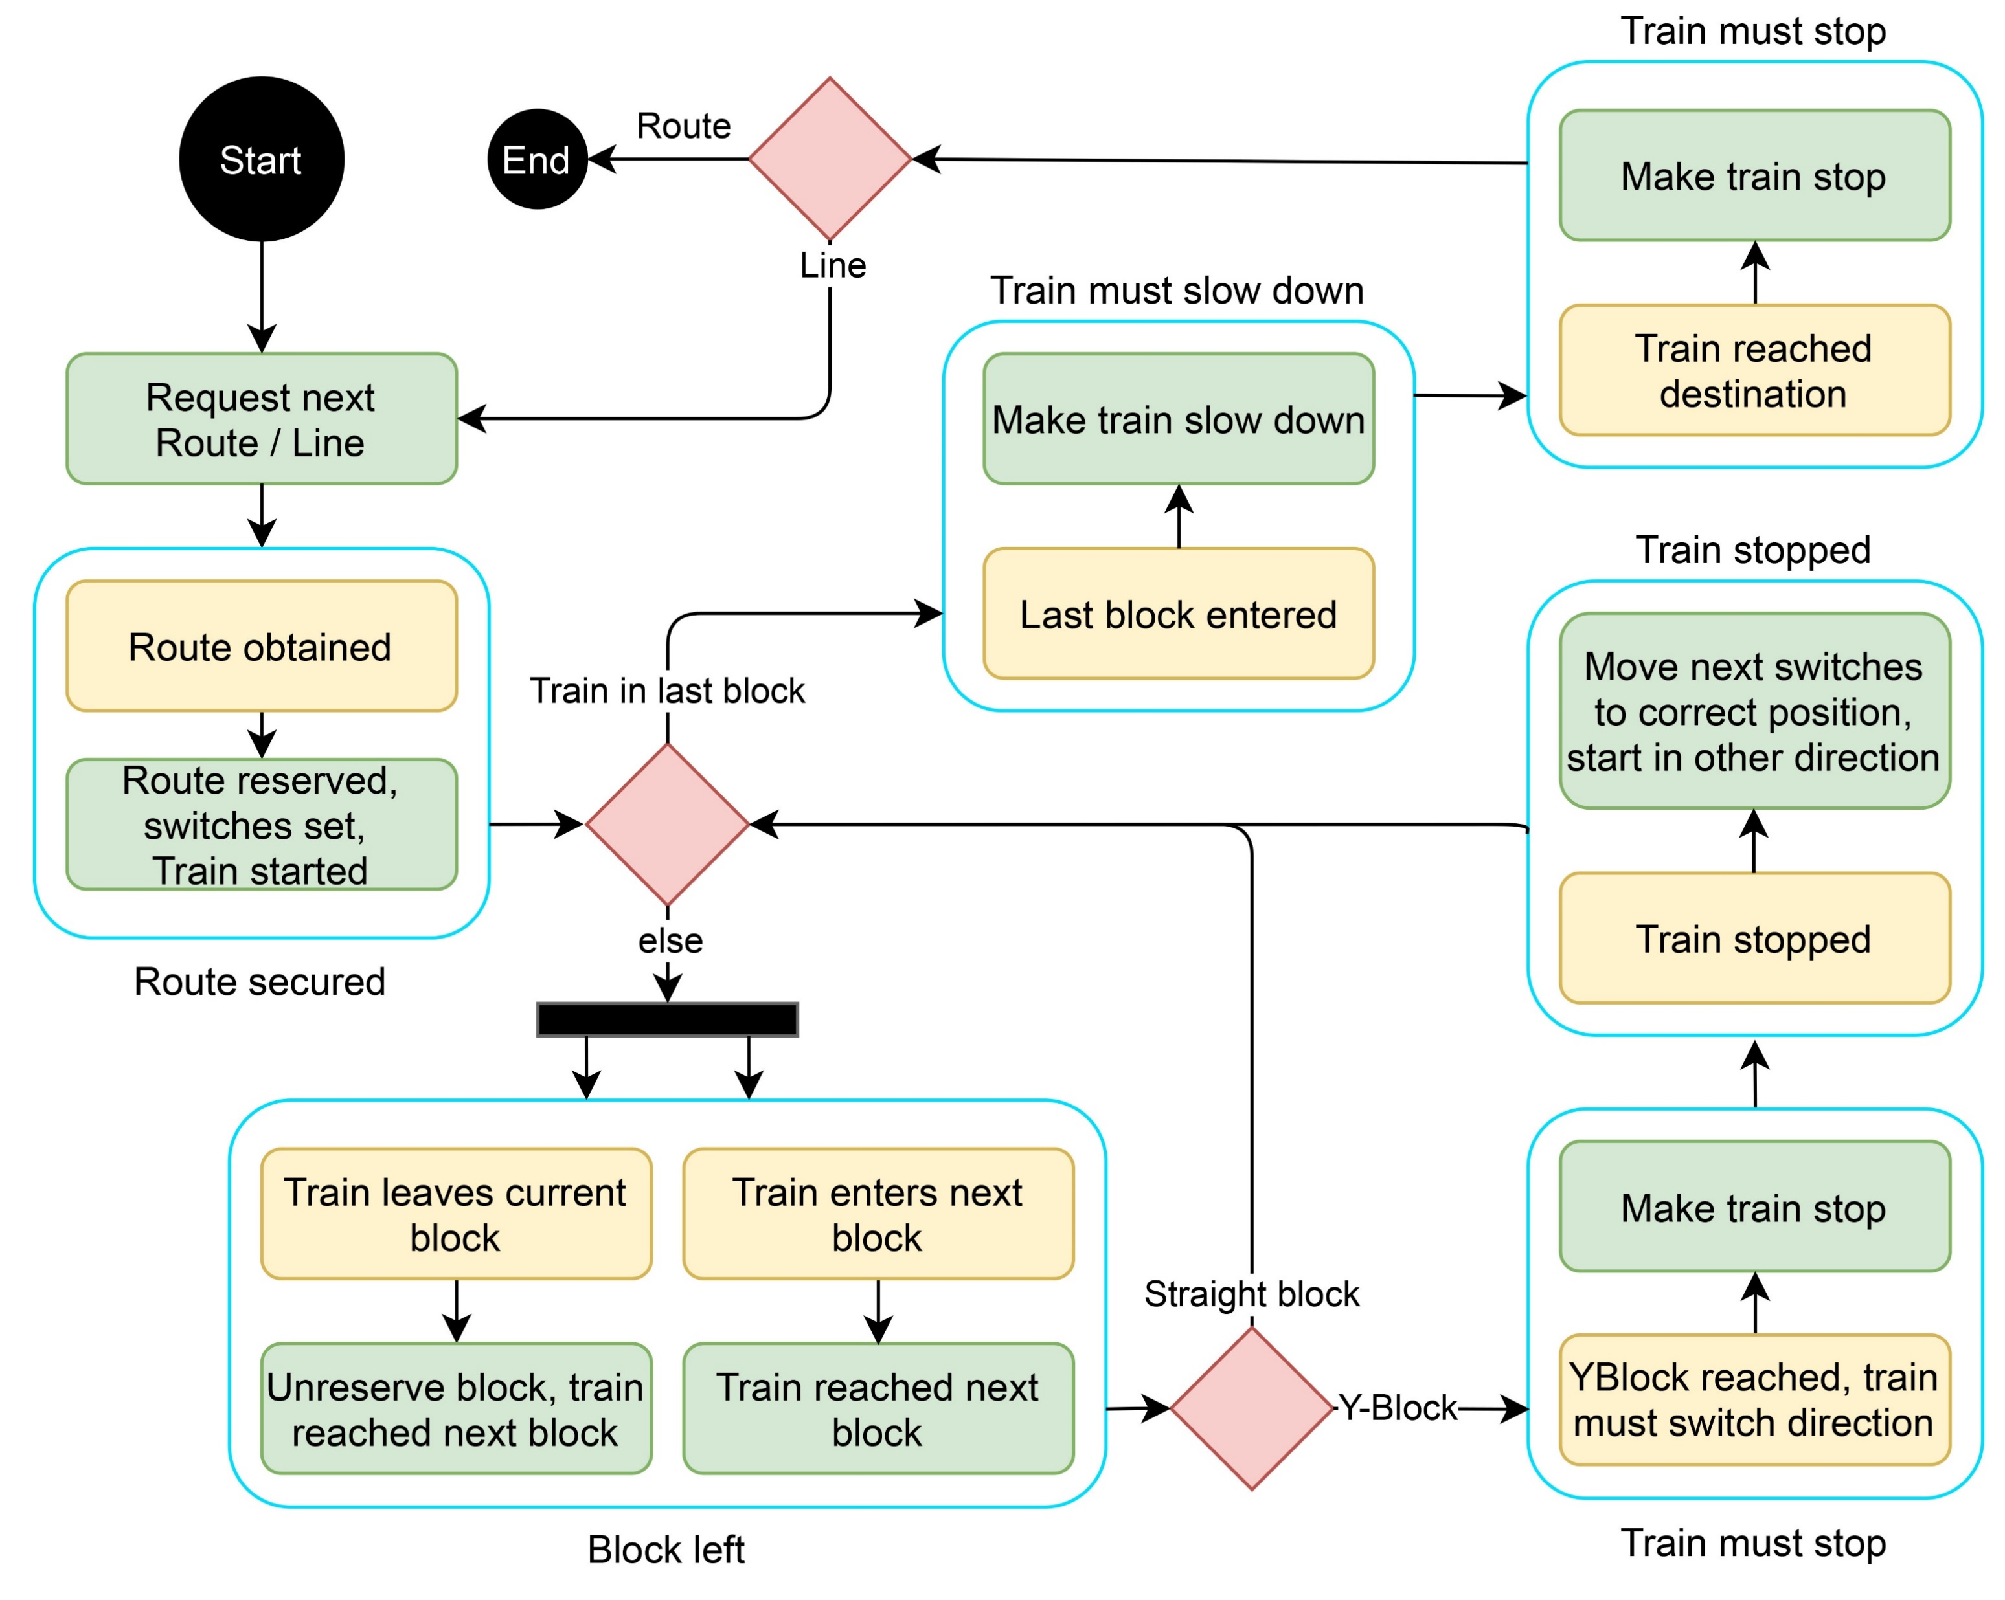

Slide 20
Demonstration

Slide 21
Implementation decisions
A Line interrupted by a manual Train stops the Line
When reverting direction of a train in MANUAL, first stop
Simultaneous lines

Slide 22
Major difficulties
The smaller the error, the greater the problem
A lot of practical tests!

Slide 23
Possible improvements
MANUAL mode : more observers and manage switches
Better train’s signalId update (Automatic to Manual)
Graphical improvements

